Slide 1
Input/Output Organization <number>
Overview
Peripheral Devices
Input-Output Interface
Asynchronous Data Transfer
Modes of Transfer
Priority Interrupt
Direct Memory Access
Input-Output Processor
Serial Communication

Slide 2
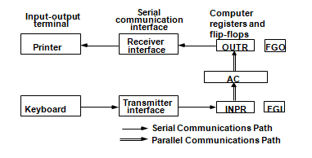

Slide 3
Input/Output Organization <number>
Input Output Organization
  I/O Subsystem
    Provides an efficient mode of communication between the central system and the outside environment
  Programs and data must be entered into computer memory for processing and results obtained from computer must be recorded and displayed to user.
  When input transferred via slow keyboard processor will be idle most of the time waiting for information to arrive
      Magnetic tapes, disks

Slide 4
Input/Output Organization <number>
Peripheral Devices
Devices that are under direct control of computer are said to be connected on-line.
Input or output devices attached to the computer are also called peripherals.
There are three types of peripherals :
  Input peripherals
  Output peripherals
  Input-output peripherals
  Peripheral (or I/O Device)
      Monitor (Visual Output Device) : CRT, LCD
      KeyBoard (Input Device) : light pen, mouse, touch screen, joy stick, digitizer
      Printer (Hard Copy Device) : Daisy wheel, dot matrix and laser printer
      Storage Device : Magnetic tape, magnetic disk, optical disk

Slide 5
Input/Output Organization <number>
Peripheral Devices
Input Devices
Output Devices
Keyboard
Optical input devices
- Card Reader
- Paper Tape Reader
- Bar code reader
- Optical Mark Reader
Magnetic Input Devices
- Magnetic Stripe Reader
Screen Input Devices
- Touch Screen
- Light Pen
- Mouse
Card Puncher, Paper Tape Puncher
CRT
Printer (Daisy Wheel, Dot Matrix, Laser)
Plotter

Slide 6
Input/Output Organization <number>
Input Output Organization
  ASCII (American Standard Code for Information Interchange)
    I/O communications usually involves transfer of alphanumeric
    information from the device and the computer.
    Standard binary code for alphanumeric character is ASCII
    ASCII Code :
      It uses 7 bits to code 128 characters (94 printable and 34 non printing)
      7 bit - 00 - 7F ( 0 - 127 )
    ASCII is 7 bits but most computers manipulate 8 bit quantity as a
    single unit called byte.
        80 - FF ( 128 - 255 ) : Greek, Italic type font
    Three types of control characters: Format effectors, Information separators and communication control

Slide 7
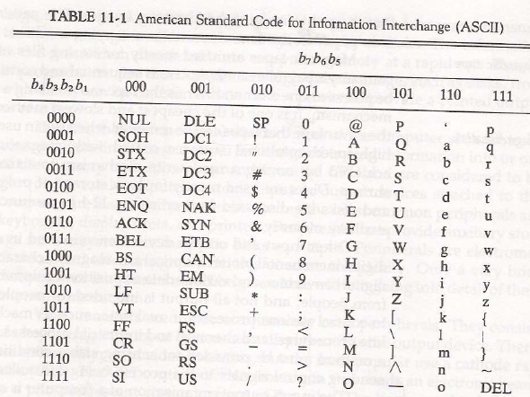

Slide 8
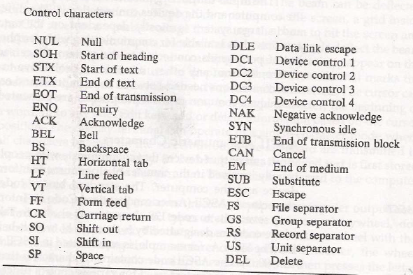

Slide 9
Format Effectors: control the layout of printing. They include familiar typewriter controls, such as backspace (BS), horizontal tabulation(HT), carriage return(CR).
Information separators: used to separate data into divisions like paragraphs and pages. They include characters such as record separator (RS) and file separator(FS).
Communication Control characters: these are useful during the transmission of text between remote terminals. These include STX(Start of text) and ETX(end of text)

Slide 10
Input/Output Organization <number>
I/O Interface
Provides a method for transferring information between internal storage (such as memory and CPU registers) and external I/O devices
Resolves the differences between the computer and peripheral devices
  (1). Peripherals – Electromechanical or Electromagnetic Devices
  CPU or Memory - Electronic Device
      Conversion of signal values required
  (2). Data Transfer Rate
    Peripherals - Usually slower
    CPU or Memory - Usually faster than peripherals
      Some kinds of Synchronization mechanism may be needed
  (3). Data formats or Unit of Information
    Peripherals – Byte, Block, …
    CPU or Memory – Word
  (4). Operating modes of peripherals may differ
    must be controlled so that not to disturbed other peripherals connected to CPU

Slide 11
Input/Output Organization <number>
I/O Bus and Interface
I/O bus
Data
Processor
Address
Control
Interface
Interface
Interface
Interface
Keyboard
Magnetic
Magnetic
and
Printer
disk
tape
display
terminal
Interface :
- Decodes the device address (device code)
- Decodes the commands (operation)
- Provides signals for the peripheral controller
- Synchronizes the data flow and supervises
the transfer rate between peripheral and CPU or Memory
4 types of command interface can receive : control, status, data o/p and data i/p

Slide 12
Input/Output Organization <number>
I/O Bus and Interface
Control command : is issued to activate peripheral and to inform what to do
Status command : used to test various status condition in the interface and
the peripherals
data o/p command : causes the interface to respond by transferring data from
the bus into one of its registers
data i/p command : interface receives an item of data from the peripheral and
places it in its buffer register.

Slide 13
Input/Output Organization <number>
I/O Bus and Memory Bus
Functions of Buses
  MEMORY BUS is for information transfers between CPU and the MM
  I/O BUS is for information transfers between CPU and I/O devices through their I/O interface
  3 ways to bus can communicate with memory and I/O :
  (1). use two separate buses, one to communicate with memory and the
  other with I/O interfaces
  - Computer has independent set of data, address and control bus one for
  accessing memory and another I/O.
  - done in computers that have separate IOP other than CPU.
  (2). Use one common bus for memory and I/O but separate control lines
  for each
  (3). Use one common bus for memory and I/O with common control
  lines for both

Slide 14
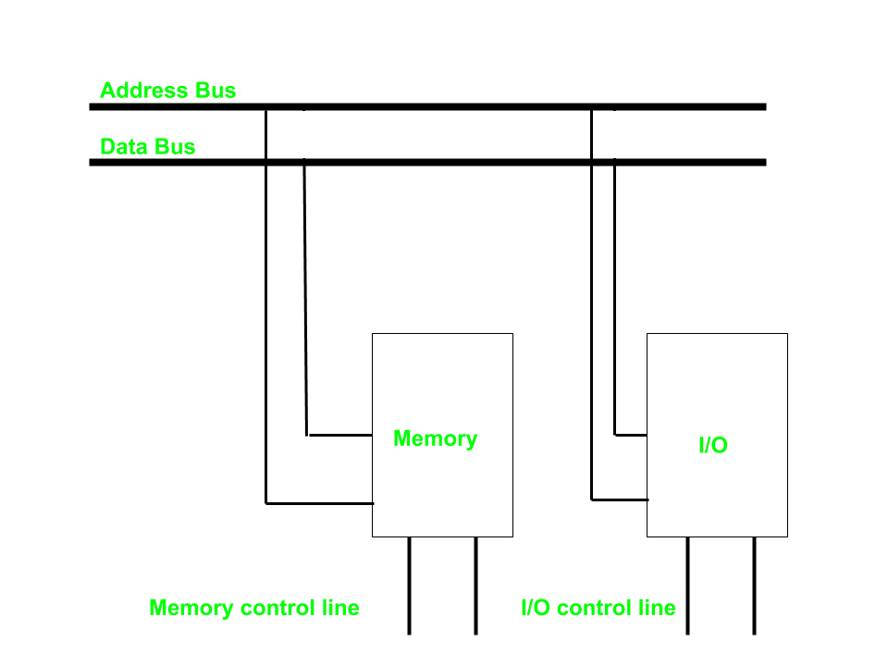
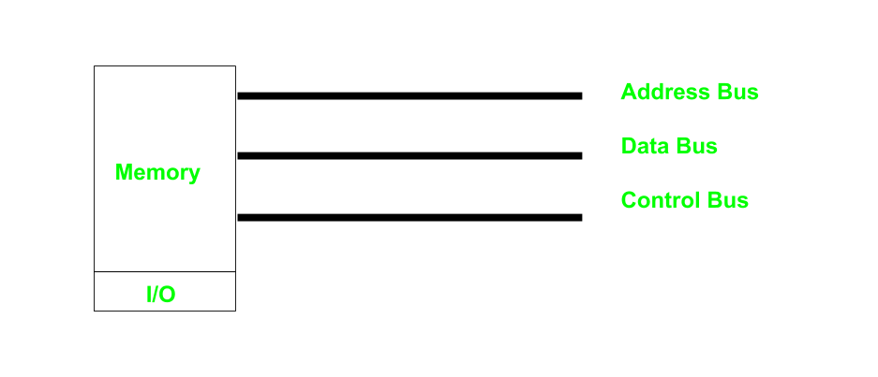

Slide 15
Input/Output Organization <number>
Isolated vs. Memory Mapped I/O
Isolated I/O
- Many computers use common bus to transfer information between memory or I/O.
- The distinction between memory transfer and I/O transfer is made through separate read and write line.
-In the isolated I/O configuration , the CPU has distinct input and output instructions and each of these instruction is associated with the address of an interface register.
Distinct input and output instructions -each associated with address of interface register
Memory-mapped I/O
  - A single set of read/write control lines
  (no distinction between memory and I/O transfer)
  - Memory and I/O addresses share the common address space
  -> reduces memory address range available
  - No specific input or output instruction
  -> The same memory reference instructions can
  be used for I/O transfers
  - Considerable flexibility in handling I/O operations

Slide 16
Input/Output Organization <number>
I/O Interface
Port A
I/O data
Bidirectional
register
Bus
data bus
buffers
I/O data
Port B
register
CPU
Chip select
I/O
Device
Register select
CS
Internal bus
RS1
Control
Control
Register select
Timing
register
RS0
and
I/O read
Control
I/O write
RD
Status
Status
WR
register
CS RS1 RS0 Register selected
0 x x None - data bus in high-impedence
1 0 0 Port A register
1 0 1 Port B register
1 1 0 Control register
Programmable Interface
1 1 1 Status register
- Information in each port can be assigned a meaning depending on the mode of operation of the I/O device→ Port A = Data; Port B = Command;
- CPU initializes(loads) each port by transferring a byte to the Control Register
→ Allows CPU can define the mode of operation of each port
→ Programmable Port: By changing the bits in the control register, it is possible to change the interface characteristics

Slide 17
Input/Output Organization <number> Lecture 36
Peripheral Devices
Input-Output Interface
Asynchronous Data Transfer
Modes of Transfer
Priority Interrupt
Direct Memory Access
Input-Output Processor

Slide 18
11-3. Asynchronous Data Transfer
→Synchronous Data Transfer: Clock pulses are applied to all registers within a unit and all data transfer among internal registers occur simultaneously during the occurrence of a clock pulse. Two units such as CPU and I/O Interface are designed independently of each other. If the registers in the interface share a common clock with CPU registers, the transfer between the two is said to be synchronous.
  →Asynchronous Data Transfer: Internal timing in each unit (CPU and Interface) is independent. Each unit uses its own private clock for internal registers. Asynchronous data transfer between two independent units requires that control signals be transmitted between the communicating units to indicate the time at which data is being transmitted. One way of achieving this is by means of STROBE(Control signal to indicate the time at which data is being transmitted) pulse and other method is HANDSHAKING(Agreement between two independent units).

Slide 19
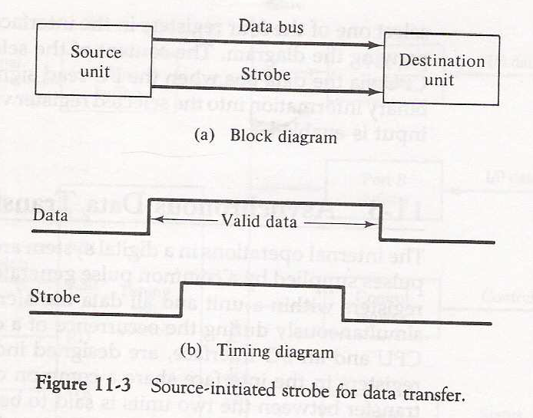
1
2

Slide 20
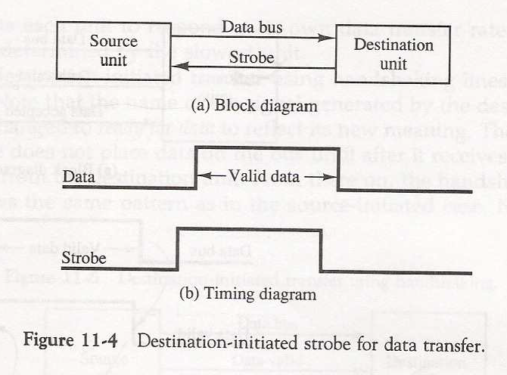
2
1

Slide 21
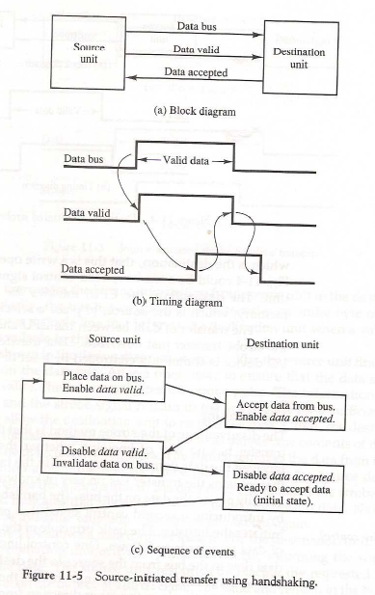

Slide 22
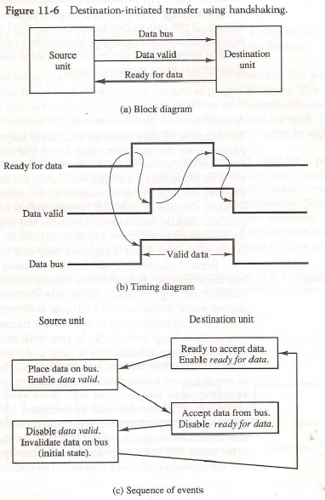
    Timeout : If the return handshake signal does not respond within a given time period, the unit assumes that an error has occurred.

Slide 23
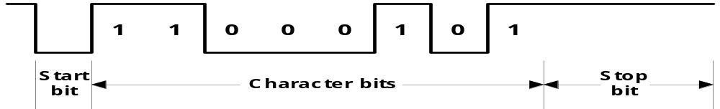
  Asynchronous Serial Transfer
    Synchronous transmission :
      The two unit share a common clock frequency
      Bits are transmitted continuously at the rate dictated by the clock pulses
    Asynchronous transmission :
      Binary information sent only when it is available and line remain idle otherwise
      Special bits are inserted at both ends of the character code
      Each character consists of three parts :
        1) start bit : always “0”, indicate the beginning of a character
        2) character bits : data
        3) stop bit : always “1”

Slide 24
    Asynchronous transmission rules :
      ① When a character is not being sent, the line is kept in the 1-state
      ② The initiation of a character transmission is detected from the start bit, which is always “0”
      ③ The character bits always follow the start bit
      ④ After the last bit of the character is transmitted, a stop bit is detected when the line returns to the 1-state for at least one bit time
    Baud Rate : Data transfer rate in bits per second
      10 character per second with 11 bit format = 110 bit per second

Slide 25
Input/Output Organization <number>
Universal Asynchronous Receiver Transmitter
A typical asynchronous communication interface available as an IC
Transmit
Bidirectional
Transmitter
Shift
data
data bus
Bus
register
register
buffers
Control
Transmitter
Transmitter
register
control
clock
Chip select
and clock
CS
Internal Bus
RS
Timing
Status
Receiver
Receiver
CS RS Oper. Register selected
register
control
clock
0 x x None
I/O read
RD
and
and clock
1 0 WR Transmitter register
Control
Receive
1 1 WR Control register
I/O write
WR
Receiver
Shift
data
1 0 RD Receiver register
register
register
1 1 RD Status register
Transmitter Register
- Accepts a data byte(from CPU) through the data bus
- Transferred to a shift register for serial transmission
Receiver Register
- Receives serial information into another shift register
- Complete data byte is sent to the receiver register
Status Register Bits
- Used for I/O flags and for recording errors
Control Register Bits
- Define baud rate, no. of bits in each character, whether to generate and check parity, and no. of stop bits

Slide 26
UART stands for?
a. Universal Asynchronous Sender Receiver
b. Universal Asynchronous Receiver Transmitter
c. Universal Synchronous Receiver Transmitter
d. None Of These.

Slide 27
Overview
Peripheral Devices
Input-Output Interface
Asynchronous Data Transfer
Modes of Transfer
Priority Interrupt
Direct Memory Access
Input-Output Processor

Slide 28
Modes of Transfer
Binary information received from external device is usually stored in memory.
Information transferred from central computer into an external device originates in the memory unit.
The CPU merely execute I/O instructions and may accept data temporarily but ultimate source or destination is the Memory Unit.
Data transfer between central computer and I/O devices may be handled in a variety of modes. Some modes use CPU as intermediate path and others transfer data directly to and from memory unit.
Data Transfer to or from peripheral can be handled in one of three possible modes :
  Programmed I/O
  Interrupt-Initiated I/O
  Direct Memory Access (DMA)

Slide 29
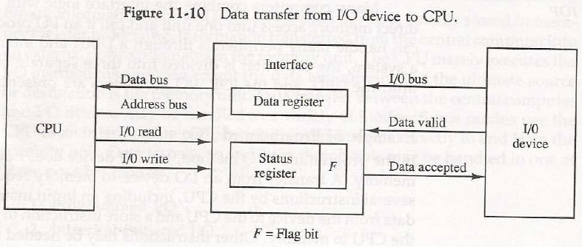
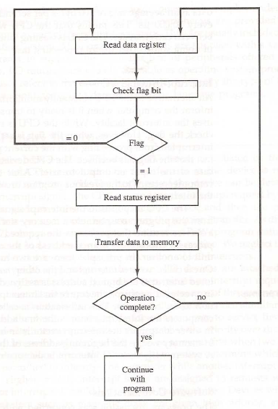
Input/output Organization <number>
Modes of Transfer – Programmed I/O

Slide 31
Programmed I/O
- Programmed I/O operations are the result of I/O Instructions written in computer program. Each data item transfer is initiated by an instruction in the program.
Usually, transfer is to and from a CPU register to peripheral. Other instructions are needed to transfer data to and from CPU and Memory
Transferring data under program control requires constant monitoring of the peripheral by CPU.

Slide 32
In programmed I/O method, CPU stays in a program loop until the I/O unit indicated that it is ready for data transfer. This is a time consuming process since it keeps the processor busy needlessly. It can be avoided by using Interrupt facility and special commands to inform the interface to issue an interrupt request signal when data are available for the device.

Slide 33
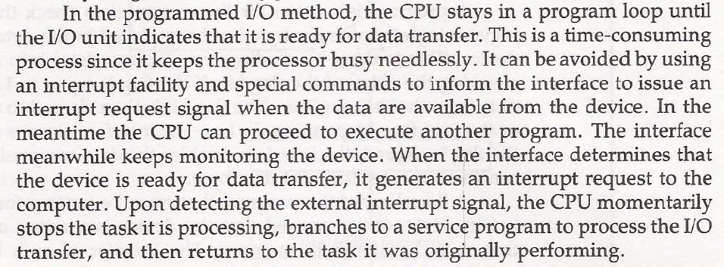
Interrupted I/O

Slide 34
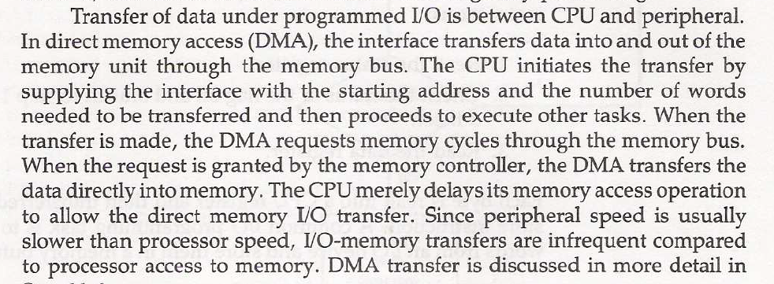
DMA

Slide 35
Priority Interrupts
Priority
- Determines which interrupt is to be served first when two or more requests
are made simultaneously
- Also determines which interrupts are permitted to interrupt the computer while
another is being serviced
- Higher priority interrupts can make requests while servicing a lower priority
interrupt
A priority interrupt is a system that establishes priority over the various sources to determine
- which condition is to serviced first when two or more requests
arrive simultaneously
-which conditions are permitted to interrupt the computer while
another request is being serviced

Slide 36
Priority Interrupts
Priority Interrupt by Software (Polling)
Polling procedure is used to identify highest priority source by software
means
- common branch address for all the interrupts
- Priority is established by the order of polling the devices(interrupt sources)
- highest priority device is tested first and if interrupt is on , control
branches to service routine for this source otherwise next lower priority
source is tested
- Flexible since it is established by software
- Low cost since it needs a very little hardware
- Very slow
- if there are many interrupt time required to poll may exceed time available to
service IO device

Slide 37
Priority Interrupts
Priority Interrupt by Hardware
- Require a priority interrupt manager which accepts all the interrupt requests
to determine the highest priority request
- Fast since identification of the highest priority interrupt request is identified by
the hardware
- Fast since each interrupt source has its own interrupt vector to access
directly to its own service routine
- Can be addressed using serial or parallel connection of interrupt lines.
Example of serial is Daisy chaining Priority

Slide 38
Hardware Priority Interrupts – Daisy Chain
VAD 1
VAD 2
VAD 3
* Serial hardware priority function
* Interrupt Request Line
- Single common line
* Interrupt Acknowledge Line
- Daisy-Chain
Device 1
Device 2
Device 3
PI
PO
PI
PO
PI
PO
To next
device
Interrupt request
INT
CPU
Interrupt acknowledge
INTACK
Serial connection of all device that request an interrupt
Device with highest priority placed in first position followed by devices with lower
priority and so on.
Interrupt generated by any device → signals low state interrupt line
CPU responds by enabling interrupt acknowledgement (INTACK) line.
device receives PI=1 and passes to next only when not requesting else PI=0
Thus device with PI=1 and PO=0 is one with highest priority requesting interrupt

Slide 39
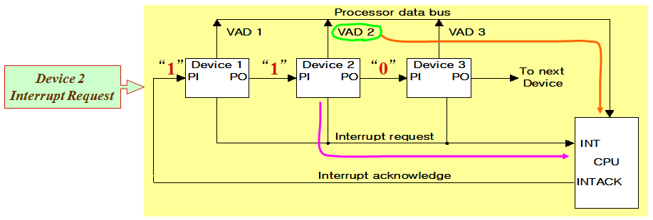
Hardware Priority Interrupts – Daisy Chain
Example: Daisy chain working

Slide 40
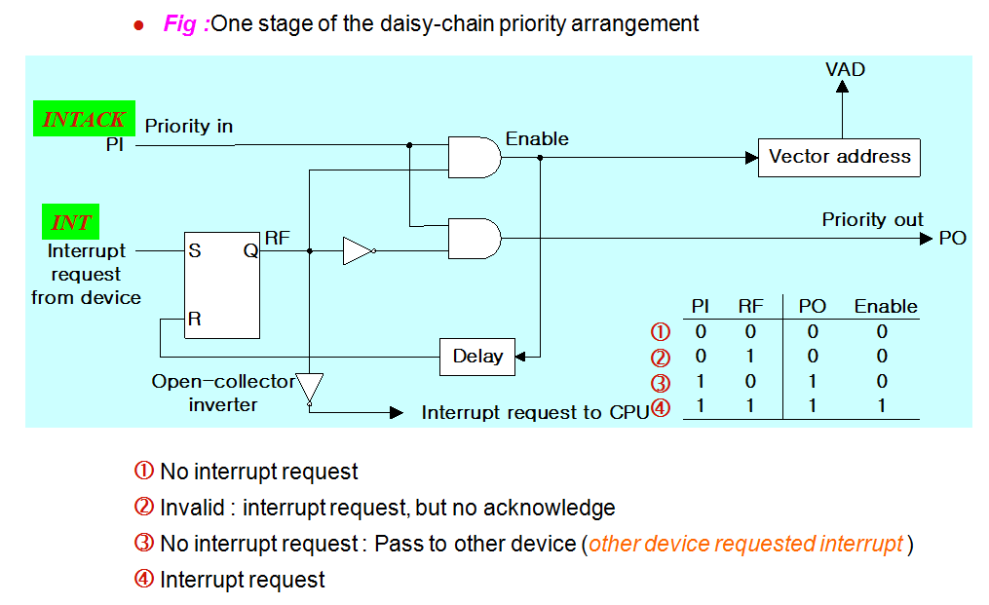
Hardware Priority Interrupts – Daisy Chain

Slide 41
Parallel Priority Interrupts
Interrupt register
Bus
Buffer
Disk
0
I
0
y
Printer
1
I
x
1
Priority
0
Reader
2
I
encoder
2
0
VAD
Keyboard
3
I
0
to CPU
3
0
0
IEN
IST
0
Mask
0
register
1
Enable
2
Interrupt
3
to CPU
INTACK
from CPU
IEN: Set or Clear by instructions ION or IOF
IST: Represents an unmasked interrupt has occurred. INTACK enables tristate Bus Buffer to load VAD generated by the Priority Logic
Interrupt Register:
- Each bit is associated with an Interrupt Request from different Interrupt Source - different priority level
- Each bit can be cleared by a program instruction
Mask Register:
- Mask Register is associated with Interrupt Register
- Each bit can be set or cleared by an Instruction

Slide 42
Priority Encoder
Determines the highest priority interrupt when more than one interrupts take place
Priority Encoder Truth table
Inputs
Outputs
I₀
I₁
I₂
I₃
x y IST
Boolean functions
1 d d d
0 0 1
0 1 d d
0 1 1
0 0 1 d
1 0 1
x = I₀' I₁'
0 0 0 1
1 1 1
y = I₀' I₁ + I₀’ I₂’
0 0 0 0
d d 0
(IST) = I₀ + I₁ + I₂ + I₃

Slide 43
Interrupt Cycle
At the end of each Instruction cycle
- CPU checks IEN and IST
- If IEN • IST = 1, CPU -> Interrupt Cycle
  SP ← SP - 1 Decrement stack pointer
  M[SP] ←  PC Push PC into stack
  INTACK ←  1 Enable interrupt acknowledge
  PC ←  VAD Transfer vector address to PC
  IEN ←  0 Disable further interrupts
  Go To Fetch to execute the first instruction
  in the interrupt service routine

Slide 44
Initial and Final Operations
0
JMP DISK
DISK
7
Program to service
1
JMP PTR
magnetic disk
VAD=00000011
3
2
JMP RDR
PTR
Program to service
3
JMP KBD
8
line printer
KBD
interrupt
1
Main program
RDR
749
current instr.
Program to service
750
character reader
KBD
4
Stack
Program to service
11
5
keyboard
2
256
Disk
interrupt
255
256
750
Initial and Final Operations
6
9
10
Each interrupt service routine must have an initial and final set of
operations for controlling the registers in the hardware interrupt system
Initial Sequence
[1] Clear lower level Mask reg. bits
[2] IST <- 0
[3] Save contents of CPU registers
[4] IEN <- 1
[5] Go to Interrupt Service Routine
Final Sequence
[1] IEN <- 0
[2] Restore CPU registers
[3] Clear the bit in the Interrupt Reg
[4] Set lower level Mask reg. bits
[5] Restore return address, IEN <- 1

Slide 45
In Daisy Chaining Priority if the device does not have any pending interrupt requests then the value of PI and PO will be
a. PI=0, PO=0
b. PI=0, PO=1
c. PI=1, PO=0
d. PI=1, PO=1

Slide 46
Input/Output Organization <number>
Overview
Peripheral Devices
Input-Output Interface
Asynchronous Data Transfer
Modes of Transfer
Priority Interrupt
Direct Memory Access
Input-Output Processor

Slide 47
Input/Output Organization <number>
Direct Memory Access
* Block of data transfer between high speed devices like Disk and Memory
* DMA controller - Interface which takes over the buses to manage the transfer directly between
Memory and I/O Device, freeing CPU for other tasks
* CPU initializes DMA Controller by sending memory address and the block size (number of words)
Fig 1: CPU bus signals for DMA transfer
ABUS
Address bus
Bus request
BR
DBUS
Data bus
Bus granted
BG
CPU
RD
Read
WR
Write
Fig 2: Block diagram of DMA controller
Data bus
Data bus
Address bus
Address register:
Contains an address to specify
Desired location in memory
Word count register
Holds no. of words to be transferred
Control register
Specifies the mode of transfer
buffers
buffers
DMA select
DS
Address register
RS
Internal Bus
Read
RD
Word count register
Write
WR
Control
logic
Control register
Bus request
BR
Bus grant
BG
Interrupt
Interrupt
DMA request
DMA acknowledge
to I/O device

Slide 48
Input/Output Organization <number>
Direct Memory Access
RD and WR is bidirectional
When BG=0 CPU can communicate with DMA Register
When BG=1 CPU left the buses and DMA can communicate directly with memory
DMA Transfer can be made in several ways
Burst Transfer : a block sequence consisting of memory words is transferred
in continuous burst while the DMA controller is master of memory
bus
- This mode of transfer is needed for fast devices such as magnetic
disk where data transmission cannot be stopped or slowed down
until an entire block is transferred
(2) Cycle stealing : Alternative technique called cycle stealing allows DMA controller to
transfer one data word at time after which it must return control of
the buses to the CPU.
- CPU merely delays its operation for one memory cycle to allow the
direct memory I/O transfer to “steal” one memory cycle

Slide 49
Input/Output Organization <number>
DMA I/O Operation
DMA is first initialized by CPU. After that DMA starts and continues to transfer data between memory and peripheral unit until an entire block is transferred.
CPU initializes the DMA by sending following information through data bus:
    (1) Starting address of the memory block (for read/write)
    (2) Word Count (no. of words in memory block)
    (3) Control to specify mode of transfer (E.g. read/write)
    (4) A control to start DMA Transfer

Slide 50
Input/Output Organization <number>
Cycle Stealing
While DMA I/O takes place, CPU is also executing instructions
DMA Controller and CPU both access Memory -> Memory Access Conflict
Memory Bus Controller
- Coordinating the activities of all devices requesting memory access
- Priority System
Memory accesses by CPU and DMA Controller are interwoven,
with the top priority given to DMA Controller
Cycle Steal
- CPU is usually much faster than I/O(DMA), thus
CPU uses the most of the memory cycles
- DMA Controller steals the memory cycles from CPU
- For those stolen cycles, CPU remains idle
- For those slow CPU, DMA Controller may steal most of the memory
cycles which may cause CPU remain idle long time

Slide 51
Input/Output Organization <number>
DMA Transfer
Interrupt
BG
Random-access
CPU
memory unit (RAM)
BR
RD
WR
Addr
Data
RD
WR
Addr
Data
Read control
Write control
Data bus
Address bus
Address
select
RD
WR
Addr
Data
DS
DMA ack.
RS
DMA
I/O
BR
Controller
Peripheral
device
BG
DMA request
Interrupt

Slide 52
Input/Output Organization <number>
I/O Processor - Channel
Channel
- Processor with direct memory access capability that communicates with I/O devices
- Channel accesses memory by cycle stealing
- Unlike DMA Controller, IOP can fetch and execute its own instruction
- IOP Instructions (Commands) specially designed to facilitate I/O transfer.
- Data gathered in IOP at device rate and bit capacity while CPU executing own program
- Transfer between IOP and Device similar to Programmed I/O and
transfer between IOP and Memory similar to DMA
- CPU is master while IOP is slave processor
- CPU initiates the channel by executing a channel I/O class instruction and once initiated, channel operates independent of the CPU
Central
processing
unit (CPU)
Peripheral devices
Memory
Memory Bus
unit
PD
PD
PD
PD
Input-output
processor
I/O bus
(IOP)

Slide 53
Input/Output Organization <number>
Channel CPU Communication
CPU operations
IOP operations
Send instruction
to test IOP.path
Transfer status word
to memory
If status OK, then send
start I/O instruction
to IOP.
Access memory
for IOP program
CPU continues with
another program
Conduct I/O transfers
using DMA;
Prepare status report.
I/O transfer completed;
Interrupt CPU
Request IOP status
Transfer status word
Check status word
to memory location
for correct transfer.
Continue

